Slide 1
Public Hearing on
CERC’s proposal on determining value of “X” for deviation error formula for Solar and Wind sellers
Prayas (Energy Group), Pune
3rd December, 2025

Slide 2
Outline
Scope of analysis done by Prayas
Sectoral developments in which analysis should be contextualised
High level comparison of CERC’s previous (2023), existing (since Sep 24) and future (April, 2026) DSM regulatory framework
  Impact of pooling, increasing penalty, tightening of band & changing X.
Key Takeaways, Recommendations

Slide 3
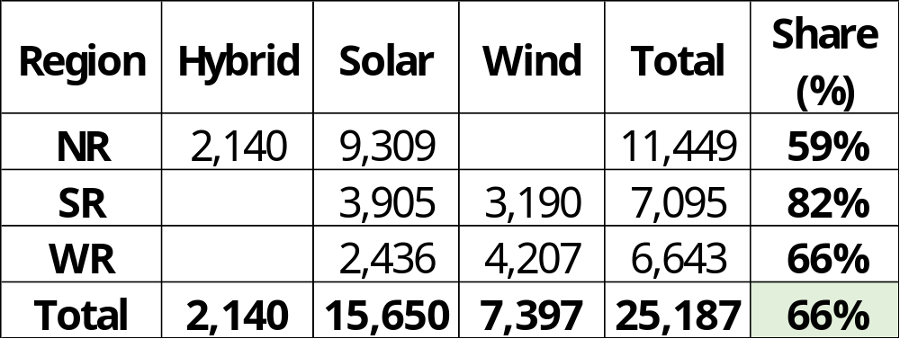
Comprehensive Analysis on DSM for WS
15-min analysis of 129 RE plants across NR, WR and SR regions
  with aggregate capacity of 25 GW RE (66% of ISTS installed capacity (38 GW) as of March 2025)
  Across 36 PSS and for 2 years (FY 24 and FY 25).
Report on this analysis covering
  scale of penalties across diff regs
  pooling & de-pooling methods
  impact of range of X values
  no payment over 50.05 Hz of OI;
  treatment as General Seller etc.
  To be published soon.
Analysis comparing regulatory framework of 2023 (previous), 2024 (existing) and 2026 (future)

Slide 4
Analysis to be seen in the context of sector developments
RE share in generation expected to grow from 23% to >40% by 2030.
  ~49 GW RE at ISTS (Oct 2025), ~10.5 GW added in current FY 26; ~140 GW connectivity applications with CTU.
  Solar capacity now at 33% of peak load, day time prices are consistently the lowest. By 2027, solar could be 70% of peak demand and reach ~100% by as early as 2032.
4 suo-motu orders from CERC on system operation in recent past.
  Directions in the interest of grid security (2022, 2023)
  Planning for safe, secure, and reliable integrated operation of the power system during critical periods (2024 and 2025).
Petition before CERC on RE generators non-adherence to CEA connectivity standards.
  Non-desirable performance of ISTS RE during fault events leading to major generation loss and frequency dip and other associated matters.
The CERC DSM framework from April 26 will set the Rules broadly until 2030, need to plan long-term.

Slide 5
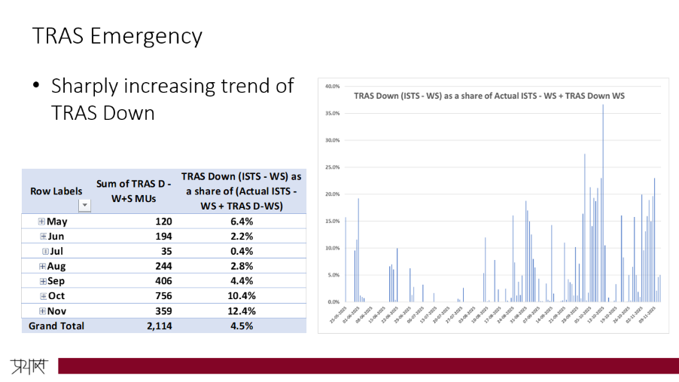
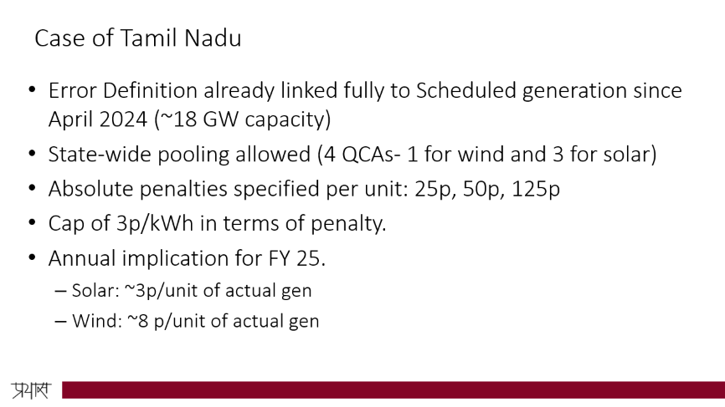
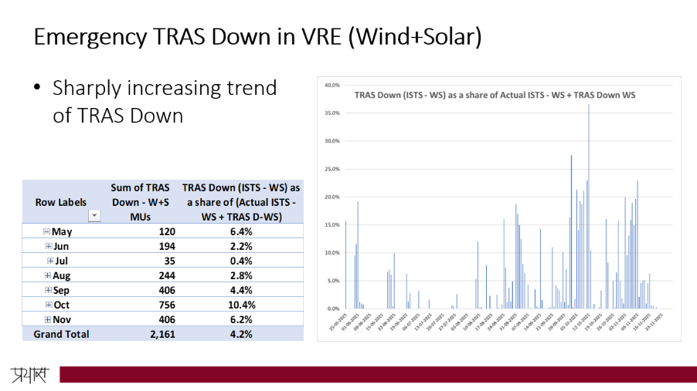
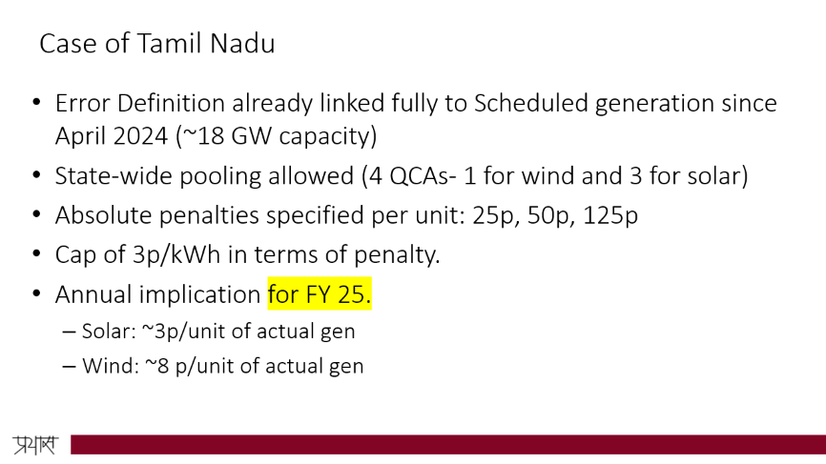
Analysis should be seen in the context of…2
TNERC already has moved to X=0 (scheduled based error accounting)
RE curtailment - TRAS Emergency Down trends from last 6 months.

Slide 6
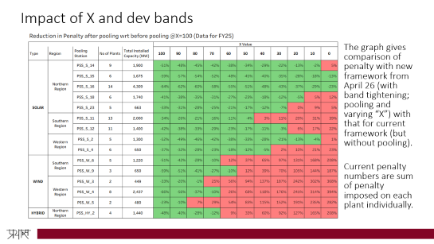
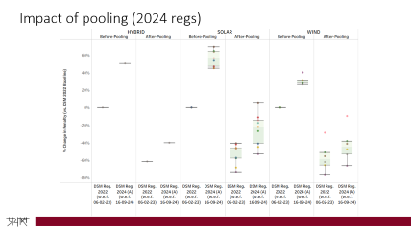
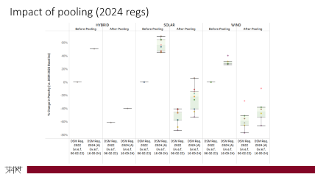
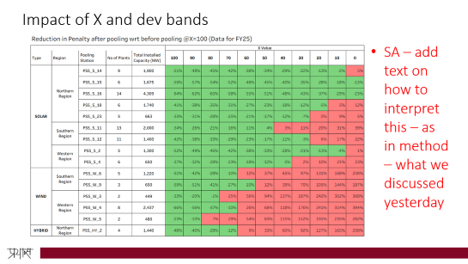
Evolution of DSM framework for solar and wind sellers
2022-23 (previous)
2024 (existing)
2026 (future)
Error linked to AvC
Dev bands
  Wind: 15%, 20%, >20%
  Solar/ hybrid: 10%, 15%, >15%
Penalty
  OI: 0,10%,100%
  UI: 0%, 10%, 50%
No pooling
Pooling Allowed
Penalty
  UI: 0%, 10%, 100%
Error linked to AvC and Sch. Gen through ‘X’
Dev bands tightened
  Wind: 10%, 15%, >15%
  Solar/hybrid: 5%, 10%, >10%
Impact of 2024 regs on Penalty (mainly due to pooling)
Wind: 40-65% reduction
Solar: 10-50% reduction
Hybrid: 40% reduction
* % reduction or increase is w.r.t. 2022 regs

Slide 7
Key takeaways & Recommendations
Pooling significantly beneficial for RE generators
  Already 90% capacity in NR, 56% in SR and 75% in WR seem to be pooling.
Strongly support CERC and the need for phased transition to X;
  Or else revenue implications on generators despite pooling benefit.
Need to have different treatment for Solar, Wind and Hybrid
  In our opinion, CERC may fix value of X for 2 years initially
    Solar: X = ~50% & Wind and Hybrid: X = ~60-70%; All Hybrid not the same (FDRE, RTC, Solar+ESS etc.)
  Link to Scheduled generation completely by FY 28 or latest by FY 30
    i.e. X=0 or X=5% (as per SRPC suggestion)
Scale of new upcoming RE significantly higher than existing RE, better to have same but more stringent level playing field for new tendered capacity after April, 2026.
  Without stringent framework, no incentive for integrating ESS.
Our analysis on treating new RE as GS and no payment for over-injection when f>50.05 ready, will be shared soon.

Slide 8

Thank you
Ashwin Gambhir <ashwin@prayaspune.org>
Saumendra Aggrawal <saumendra@prayaspune.org>
Prajwal Thakre <prajwal@prayaspune.org>
https://energy.prayaspune.org/

Slide 9
Additional Slides

Slide 10
Case of Tamil Nadu
Error Definition already linked fully to Scheduled generation since April 2024 (~18 GW capacity)
State-wide pooling allowed (4 QCAs- 1 for wind and 3 for solar)
Absolute penalties specified per unit: 25p, 50p, 125p
Cap of 3p/kWh in terms of penalty.
Annual implication for FY 25.
  Solar: ~3p/unit of actual gen
  Wind: ~8 p/unit of actual gen

Slide 11
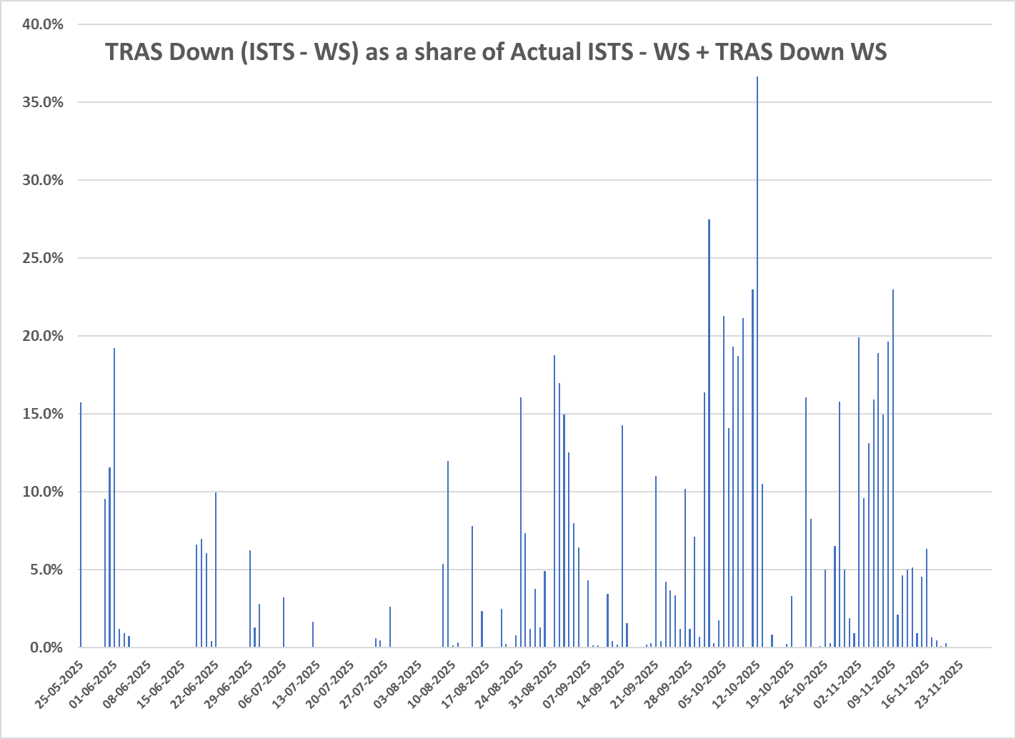
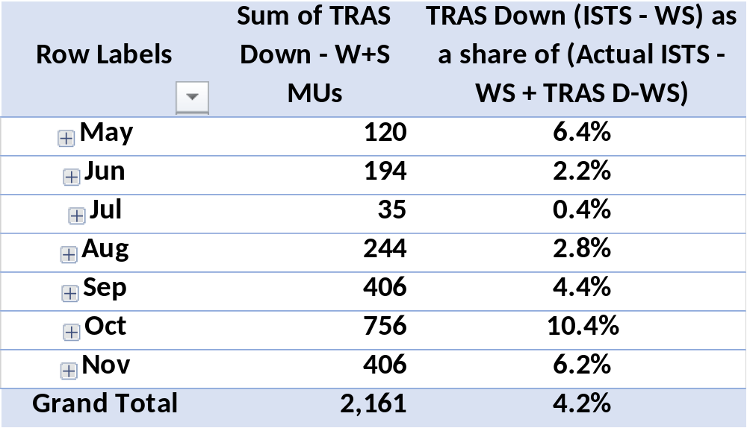
Emergency TRAS Down in VRE (Wind+Solar)
Sharply increasing trend of TRAS Down

Slide 12
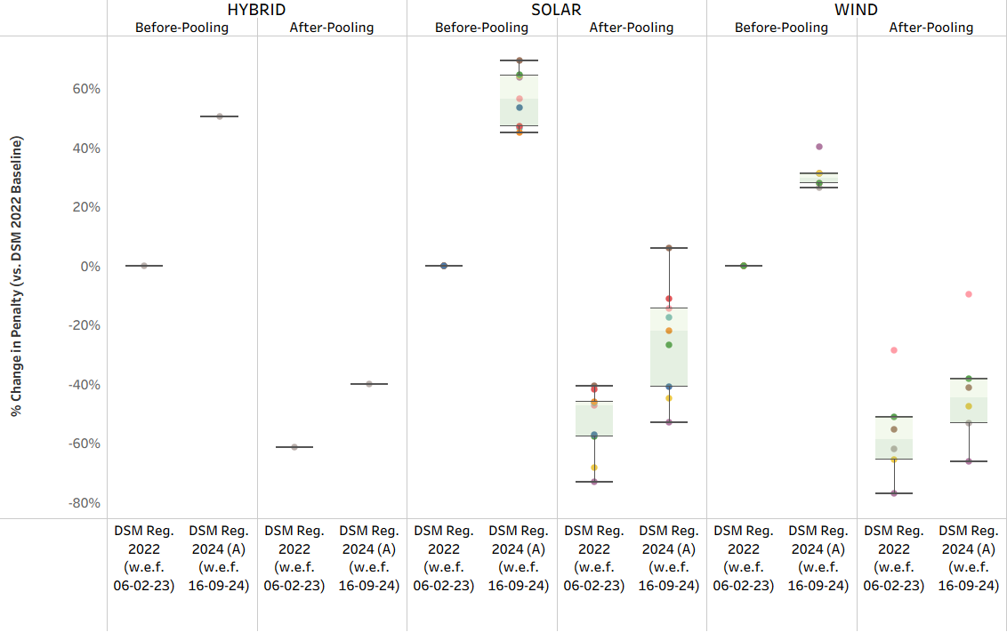
Impact of pooling (2024 regs)

Slide 13
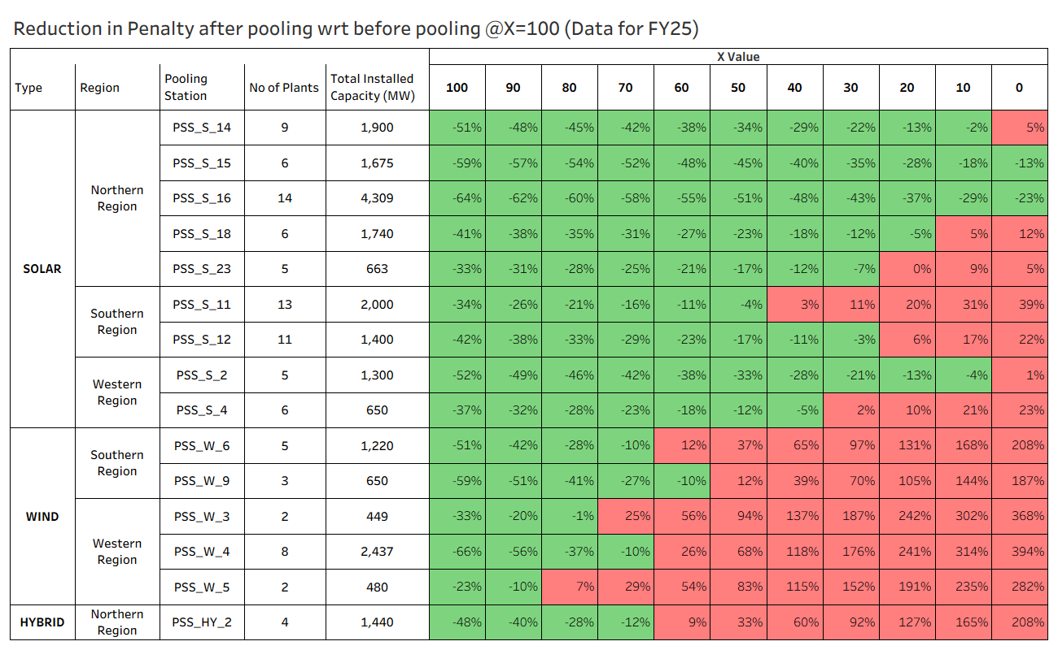
Impact of X and dev bands
The graph gives comparison of penalty with new framework from April 26 (with band tightening; pooling and varying “X”) with that for current framework (but without pooling).
Current penalty numbers are sum of penalty imposed on each plant individually.

